Slide 1
Community Partnerships- Literacy Beyond the Classroom

Slide 2
Community Partnerships- Why?
Notes:
School life- everyone is peddling as fast as they can??School readiness, two generation, family support

Slide 3
Purpose
Our mission is to improve outcomes for children and families by focusing on the whole child beyond the classroom.
Notes:
Clear focus…..birth to graduation….the purpose remains no matter what the funding source.

Slide 4
Get GA Reading Pillars- Provided Focus
Notes:
Helped focus the work….positive learning climate is for school and HOME

Slide 5
Everyone is Part of the Flock
Notes:
Collaboration, team work, flexible, willing, open-minded, school is perceived as a closed system, everyone takes lead at different times

Slide 6
Collaboration
Notes:
Collaboration- trust, building relationships, risk failure- just start somewhere- work with the partners you have

Slide 7
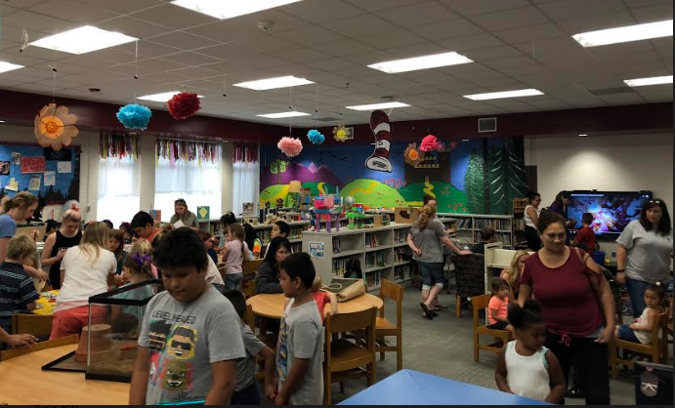
Working through Barriers
Notes:
Access to print, family engagement, birth to 8, barriers- cost of energy etc….now no one asks; just get started- not afraid to fail

Slide 8
Think Outside the Box
Notes:
Think outside the box- whole child

Slide 9
Teacher Preparation
Impact on Families
Professors Stay Current
Notes:
Impact families and professors work with the families and teach the classes- Boots on the ground- stay current

Slide 10
Evaluation
Assessment VS Evaluation
Measure the Outcomes
Notes:
Get the stories, measure the results, make changes when needed

Slide 11
Whitfield County Schools

